Slide 1
GARBAGE MONITORING SYSTEM

Slide 2
OVERVIEW
We are living in an age where tasks and systems are fusing together with the power of IOT to have a more efficient system of working and to execute jobs quickly! With all the power at our finger tips this is what we have come up with. One of the main concerns with our environment has been solid waste management which impacts the health and environment of our society. The detection, monitoring and management of wastes is one of the primary problems of the present era. This is our solution, a method in which waste management is automated. This is our IoT Garbage Monitoring system, an innovative way that will help to keep the cities clean and healthy.

Slide 3
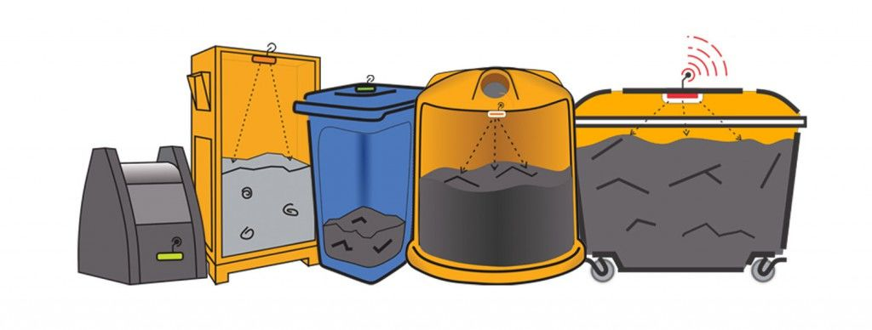
THE IDEA
The idea struck us when we observed that the garbage truck use to go around the town to collect solid waste twice a day. Although this system was thorough it was very inefficient. For example let's say street A is a busy street and we see that the garbage fills up really fast whereas maybe street B even after two days the bin isn't even half full.
What our system does is it gives a real time indicator of the garbage level in a trashcan at any given time. Using that data we can then optimize waste collection routes and ultimately reduce fuel consumption. It allows trash collectors to plan their daily/weekly pick up schedule.

Slide 4
COMPONETS IN OUR SYSTEM
To start with you will first have to enter the height of the dustbin. This will help us generate the percentage of trash in the trashcan. We then have two criterias which needs to be satisfied to show that the particular bin needs to be emptied :
The amount of trash, in other words let's say if your bin is half full you don't really need to empty it. Our thresh, or maximum amount that we permit of trash, is 75% of the bin. (You could alter the thresh according to your preference.)
If supposing a particular trashcan fills up 20% and then for a week doesn't change, it comes into our second criteria, time. With time even the little amount will start rotting leading to a smelly surrounding. To avoid that our tolerance level is 2 days, so if a trashcan is less than 75% but it is two days old it then will also need to be emptied.

Slide 5
TECHNICAL
With these criterias in mind let's understand the technical part:
An ultrasonic sensor (A.K.A a distance sensor) will be placed on the interior side of the lid, the one facing the solid waste. As trash increases, the distance between the ultrasonic and the trash decreases. This live data will be sent to our micro-controller.
Our micro- controller then processes the data and through the help of WiFi sends it to an app.
What the app does it visually represents the amount of trash in the bin with a small animation.
This process will indicate all the bins which require attention, leading the user to take the most effective route.

Slide 6
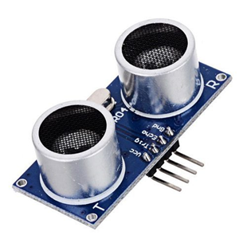
HARDWARE
Plastic Container :I found an old plastic container in which all the components could fit. The box is important as you can easily access the components and it's waterproof.
Ultrasonic Sensor : An ultrasonic sensor measures distance. It will be attached to the lid indicating the quantity of trash. Our system's key component.

Slide 7
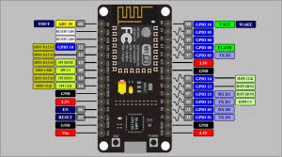
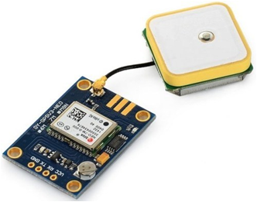
HARDWARE
Jumper Wires : To connect various componets in the system.
NodeMCU ESP8266: The center piece is one of Arduino's latest micro-controller, which simplifies the task of connecting to the Internet using prebuilt libraries that can be downloaded.
GPS Module: The Global Positioning System (GPS) is a satellite-based navigation system made up of at least 24 satellites. GPS works in any weather conditions, anywhere in the world, 24 hours a day, with no subscription fees or setup charges. It helps to track the locations of various garbage collection bins. It costs around ₹700-800/-.

Slide 8
COST
COMPONENTS | QUANTITY | PRICE
GPS Module | 1 | 750
Ultrasonic Sensor | 1 | 100
NODEMCU ESP8266 | 1 | 350
LEDs | 3 | 15
Connecting wires | 10 | 25

Slide 9
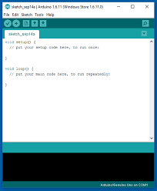
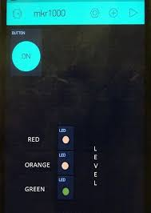
SOFTWARE
Arduino IDE
Blynk :An android app that allows communication with WiFi compatible micro-controllers.

Slide 10
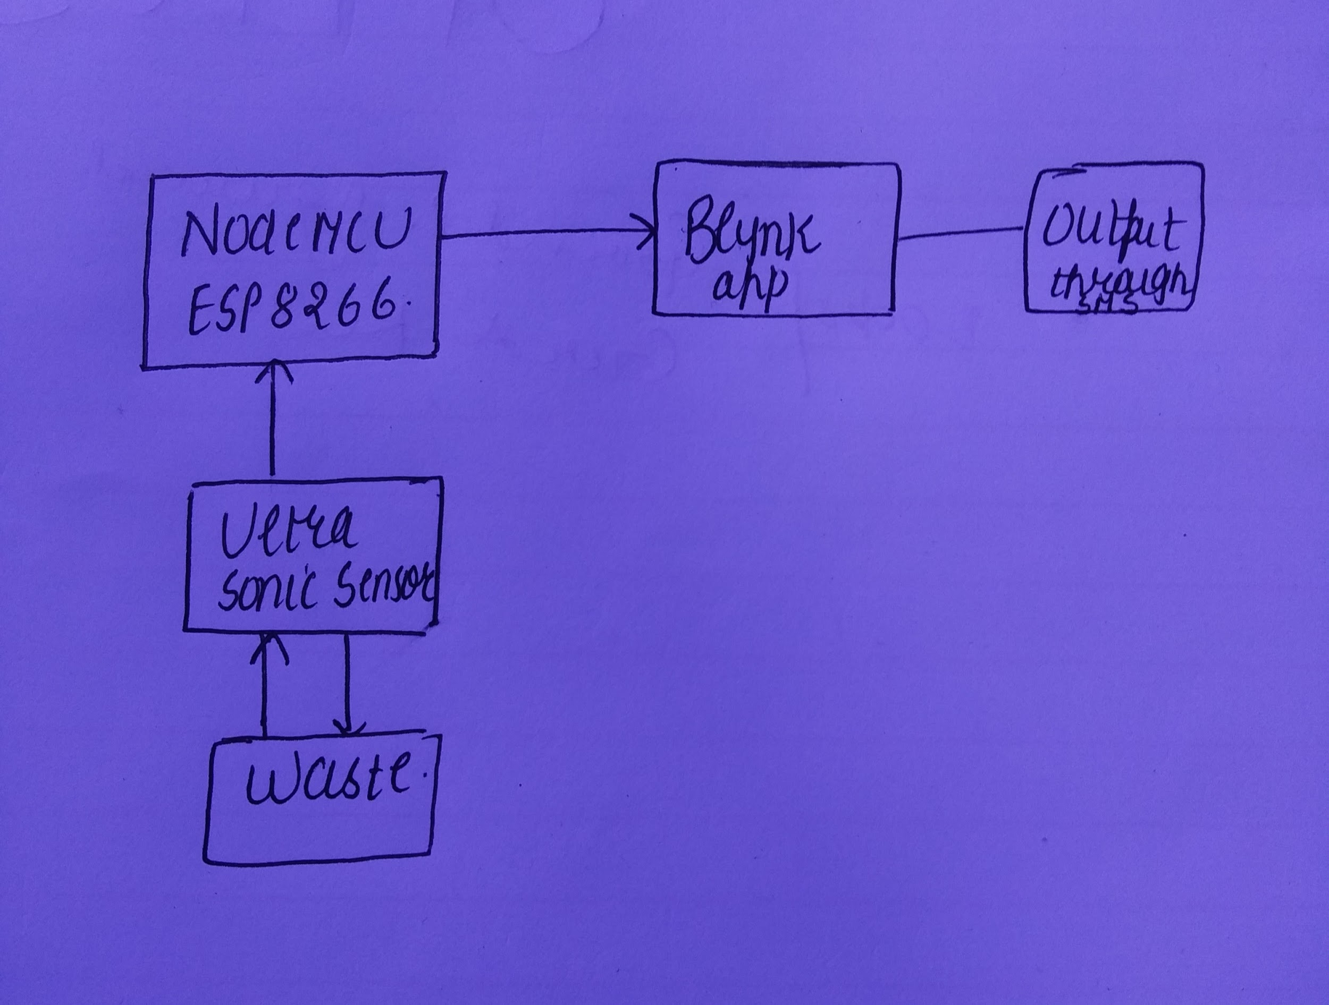
BLOCK DIAGRAM

Slide 11
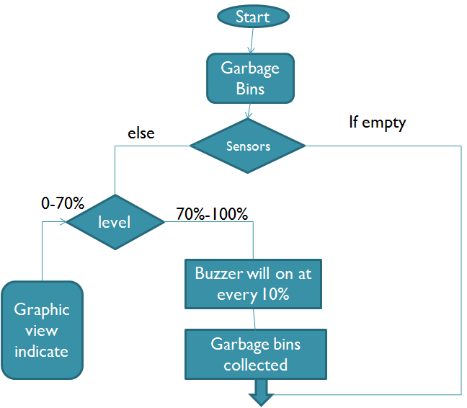
FLOW CHART:

Slide 12
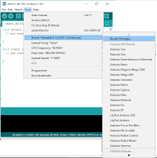
PROCEDURE
To be able to program the nodemcusp8266, you need to first install the drivers. To check if you already have them installed open the arduino IDE, click on toolsthen boards and look if either NODEMCU or esp8266 are in the list. If they are there skip to next step, if not follow along…
To download the necessary drivers to be able to use nodemcu esp8266, open the arduino IDE again, click on tools, boards, then boards manager.

Slide 13
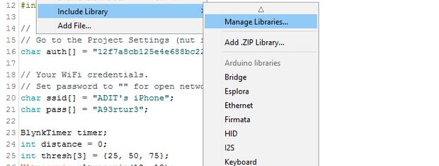
PROCEDURE
Once your drivers are installed, go ahead and download the libraries needed. For our program to run we need the WiFi101 library, the blynk library and the ultrasonic library, both can be found in arduino's in built library manager. Open to sketch then include library then library manager.

Slide 14
PROCEDURE
Once you've installed the libraries and drivers, connect the ultrasonic sensor to the arduino. .
gnd on sensor goes to gnd on arduino
trig of sensor goes to pin D3(0) of NODEMCU.
echo of sensor goes to pin D4(2) of NODEMCU.

Slide 15
PROCEDURE
Carefully fit all the components in and close the box.

Slide 16
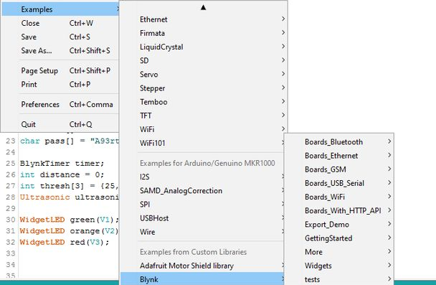
PROCEDURE
To connect to the internet we use a prebuilt platform called blynk, which can be downloaded from the android play store, link below...There are countless examples on how to use the app with the arduino which are all available by heading to files in the arduino IDE, then examples and under the blynk list.

Slide 17
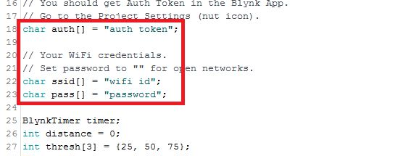
PROCEDURE
Once you are familiar with blynk and how it works, you can upload the program attached below. Some things you have to change in the program are :
replace "wifi id", with your actual wifi id
replace "password" with your actual wifi password
replace "auth token" in with your blynk's authorization token which u should have received through mail while installing blynk

Slide 18
PROCEDURE
Here you have the results of the whole concept finally working! hurray!
These are screenshots of my phone as I filled the dustbin. On the blynk application we aliggned three LEDs one on top of the other. Green which ranges from 0 to 25% full, Orange from 25 to 65% and Red from 65 to 100%

Slide 19
PROGRESS
We have studied about the components used in our project so as to understand the working of the project.
We have used ARDUINO IDE to do the necesarry coding of NODEMCU.
We are able to identify the levels of garbage in the dustbin accurately.
We are using BLYNK app to showcase the range of the levels of garbage in the dustbin by using LEDs so that the truck driver can know better.
We have implemented our project on one dustbin for the time being and it is working properly.

Slide 20
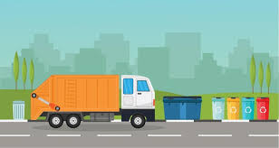
IMPLEMENTATION AND SCOPE
Our need to manually go about the town taking GPS locations of each trashcan. Then save it on your Google Maps. Once you have done that, in the same way we made the system in our model intead of one LED you will need to do the same for the number of dustbins there are. Let's say there are 20.
When the truck driver starts his day, he opens Blynk and sees all the dustbins that require attention then he selects each dustbin (each when having their specific number) and then generates the shortest and most efficient route!

Slide 21

IMPLEMENTATION AND SCOPE
After having made one ourselves we realized how widely this system could be used to turn this rather horrible cumbersome chore into a really efficient one!
The way it can impact the city or even a country on a big scale is understandable, and hopefully in the future it is implemented. But other than that each individual can benefit with this concept. A community, an apartment complex or even a house can all use this powerful tool fueled by the internet of things to make their life a whole lot simpler!

Slide 22
THANK YOU.

